Slide 1
Intro to Cloud Computing CS4037 (BCS-6A) Lecture 04
Danyal Farhat
FAST School of Computing, NUCES Lahore
09 February, 2023

Slide 2
Module 2: Cloud Economics and Billing
AWS Academy Cloud Foundations

Slide 3
Module overview
Topics
Fundamentals of pricing
Total Cost of Ownership
AWS Organizations
AWS Billing and Cost Management
Technical Support
Activities
AWS Pricing Calculator

Slide 4
Module objectives
After completing this module, you should be able to:
Explain the AWS pricing philosophy
Recognize fundamental pricing characteristics
Indicate the elements of total cost of ownership
Discuss the results of the AWS Pricing Calculator
Identify how to set up an organizational structure that simplifies billing and account visibility to review cost data.
Identify the functionality in the AWS Billing Dashboard
Identify the various AWS technical support plans and features

Slide 5
Section 1: Fundamentals of pricing
Module 2: Cloud Economics and Billing

Slide 6
AWS pricing model
Three fundamental drivers of cost with AWS
Compute
Storage
Data transfer
Charged per hour/second*
Varies by instance type *Linux only
Charged typically per GB
Outbound is aggregated and charged
Inbound has no charge (with some exceptions)
Charged typically per GB
Notes:
There are three fundamental drivers of cost with AWS: compute, storage, and outbound data transfer. These characteristics vary somewhat, depending on the AWS product and pricing model you choose.
In most cases, there is no charge for inbound data transfer or for data transfer between other AWS services within the same AWS Region. There are some exceptions, so be sure to verify data transfer rates before you begin to use the AWS service.
Outbound data transfer is aggregated across services and then charged at the outbound data transfer rate. This charge appears on the monthly statement as AWS Data Transfer Out.

Slide 7



How do you pay for AWS?
Pay for what you use
Pay less when you reserve
Pay less when you use more and as AWS grows
Notes:
This philosophy is what underlies AWS pricing. While the number and types of services offered by AWS have increased dramatically, our philosophy on pricing has not changed. At the end of each month, you pay for what you use. You can start or stop using a product at any time. No long-term contracts are required.
AWS offers a range of cloud computing services. For each service, you pay for exactly the amount of resources that you actually need. This utility-style pricing model includes:
Pay for what you use
Pay less when you reserve
Pay less when you use more
Pay even less as AWS grows
To learn more about AWS pricing, see the AWS pricing overview at https://d0.awsstatic.com/whitepapers/aws_pricing_overview.pdf.

Slide 8
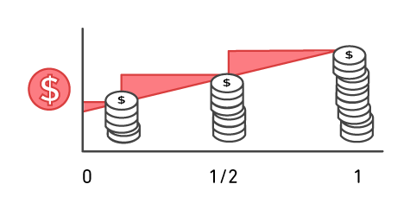
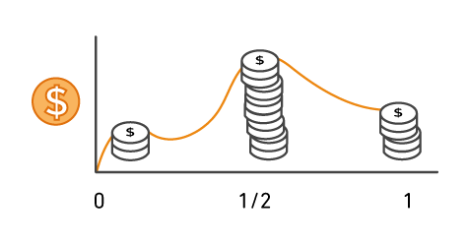
Pay for what you use
Pay only for the services that you consume, with no large upfront expenses.
On premises
AWS
Notes:
Unless you build data centers for a living, you might have spent too much time and money building them. With AWS, you pay only for the services that you consume with no large upfront expenses. You can lower variable costs, so you no longer need to dedicate valuable resources to building costly infrastructure, including purchasing servers, software licenses, or leasing facilities.
Quickly adapt to changing business needs and redirect your focus on innovation and invention by paying only for what you use and for as long as you need it. All AWS services are available on demand, require no long-term contracts, and have no complex licensing dependencies.

Slide 9





Pay less when you reserve
Invest in Reserved Instances (RIs):
Save up to 75 percent
Options:
All Upfront Reserved Instance (AURI) → largest discount
Partial Upfront Reserved Instance (PURI) → lower discounts
No Upfront Payments Reserved Instance (NURI) → smaller discount
EC2
instance
On Demand
NURI
PURI
AURI
Notes:
For certain services like Amazon Elastic Compute Cloud (Amazon EC2) and Amazon Relational Database Service (Amazon RDS), you can invest in reserved capacity. With Reserved Instances, you can save up to 75 percent over equivalent on-demand capacity. Reserved Instances are available in three options:
All Upfront Reserved Instance (or AURI)
Partial Upfront Reserved Instance (or PURI)
No Upfront Payments Reserved Instance (or NURI)
When you buy Reserved Instances, you receive a greater discount when you make a larger upfront payment. To maximize your savings, you can pay all upfront and receive the largest discount. Partial Upfront RIs offer lower discounts, but they give you the option to spend less upfront. Lastly, you can choose to spend nothing upfront and receive a smaller discount, which enables you to free capital to spend on other projects.
By using reserved capacity, your organization can minimize risks, more predictably manage budgets, and comply with policies that require longer-term commitments.

Slide 10
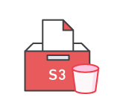
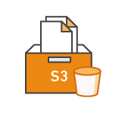
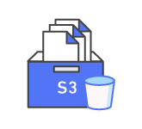


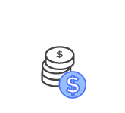
Pay less by using more
Realize volume-based discounts:
Savings as usage increases.
Tiered pricing for services like Amazon Simple Storage Service (Amazon S3), Amazon Elastic Block Store (Amazon EBS), or Amazon Elastic File System (Amazon EFS) → the more you use, the less you pay per GB.
Multiple storage services deliver lower storage costs based on needs.
Notes:
With AWS, you can get volume-based discounts and realize important savings as your usage increases. For services like Amazon Simple Storage Service (Amazon S3), pricing is tiered, which means that you pay less per GB when you use more. In addition, data transfer in is always free. Multiple storage services deliver lower storage costs based on your needs. As a result, as your AWS usage needs increase, you benefit from the economies of scale that enable you to increase adoption and keep costs under control.

Slide 11

Pay even less as AWS grows
As AWS grows:
AWS focuses on lowering cost of doing business.
This practice results in AWS passing savings from economies of scale to you.
Since 2006, AWS has lowered pricing 75 times (as of September 2019).
Future higher-performing resources replace current resources for no extra charge.
Notes:
AWS constantly focuses on reducing data center hardware costs, improving operational efficiencies, lowering power consumption, and generally lowering the cost of doing business.
These optimizations and the substantial and growing economies of scale of AWS result in passing savings back to you as lower pricing. Since 2006, AWS has lowered pricing 75 times (as of September 2019).
Another benefit of AWS growth is that future, higher-performing resources replace current ones for no extra charge.

Slide 12

Custom pricing
Meet varying needs through custom pricing.
Available for high-volume projects with unique requirements.
Notes:
AWS realizes that every customer has different needs. If none of the AWS pricing models work for your project, custom pricing is available for high-volume projects with unique requirements.

Slide 13





Services with no charge
Amazon VPC
Elastic Beanstalk**
Auto Scaling**
AWS CloudFormation**
AWS Identity and Access Management (IAM)
**Note: There might be charges associated with other AWS services that are used with these services.

Slide 14

Key takeaways
There is no charge (with some exceptions) for:
Inbound data transfer.
Data transfer between services within the same AWS Region.
Pay for what you use.
Start and stop anytime.
No long-term contracts are required.
Some services are free, but the other AWS services that they provision might not be free.
Notes:
To learn more about pricing, see AWS pricing at https://aws.amazon.com/pricing/ and AWS pricing overview at https://d0.awsstatic.com/whitepapers/aws_pricing_overview.pdf.

Slide 15
Section 2: Total Cost of Ownership
Module 2: Cloud Economics and Billing

Slide 16








On-premises versus cloud
Traditional Infrastructure
AWS Cloud
≠
Resources and administration
No upfront expense—pay for what you use
Improve time to market and agility
Equipment
Scale up and down
Self-service infrastructure
Contracts
Cost

Slide 17


What is Total Cost of Ownership (TCO)?
Total Cost of Ownership (TCO) is the financial estimate to help identify direct and indirect costs of a system.
Why use TCO?
To compare the costs of running an entire infrastructure environment or specific workload on-premises versus on AWS
To budget and build the business case for moving to the cloud

Slide 18
TCO considerations
Hardware: Server, rack chassis power distribution units (PDUs), top-of-rack (TOR) switches (and maintenance)
Software: Operating system (OS), virtualization licenses
(and maintenance)
Facilities cost
1
Server Costs
Space
Power
Cooling
Hardware: Storage disks, storage area network (SAN) or Fibre Channel (FC) switches
Storage administration costs
Facilities cost
2
Storage Costs
Space
Power
Cooling
Network hardware: Local area network (LAN) switches, load balancer bandwidth costs
Network administration costs
Facilities cost
3
Network Costs
Space
Power
Cooling
Server administration costs
4
IT Labor Costs

Slide 19
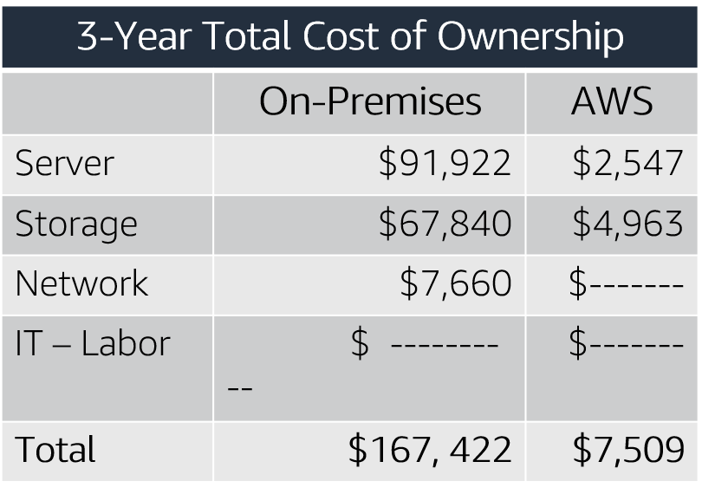
On-premises versus all-in-cloud
You could save up to 96 percent a year by moving your infrastructure to AWS.
Your 3-year total savings would be $159,913.
AWS cost includes business-level support and a 3-year PURI EC2 instance
Notes:
Here is a sample cost comparison. This example shows a cost comparison for an on-premises solution and a cloud solution over 3 years. For this comparison, two similar environments were constructed to represent the on-premises and AWS environments. Additional direct and indirect costs that are associated with the on-premises solution were not included. The components of the on-premises solution include:
1 virtual machine with 4 CPUs, 16 GB of RAM, and a Linux operating system
Average utilization is 100 percent
Optimized by RAM
The components of a comparable AWS environment include:
1 m4.xlarge instance with 4 CPUs, 16 GB of RAM
The instance type is a 3-year Partial Upfront Reserved Instance
The on-premises 3-year total cost is $167,422. The AWS Cloud 3-year total cost is $7,509, which is a 96 percent savings over the on-premises solution. Thus, the 3-year total savings on cloud infrastructure would be $159,913. This comparison helps a business clearly understand the differences between the alternatives.

Slide 20
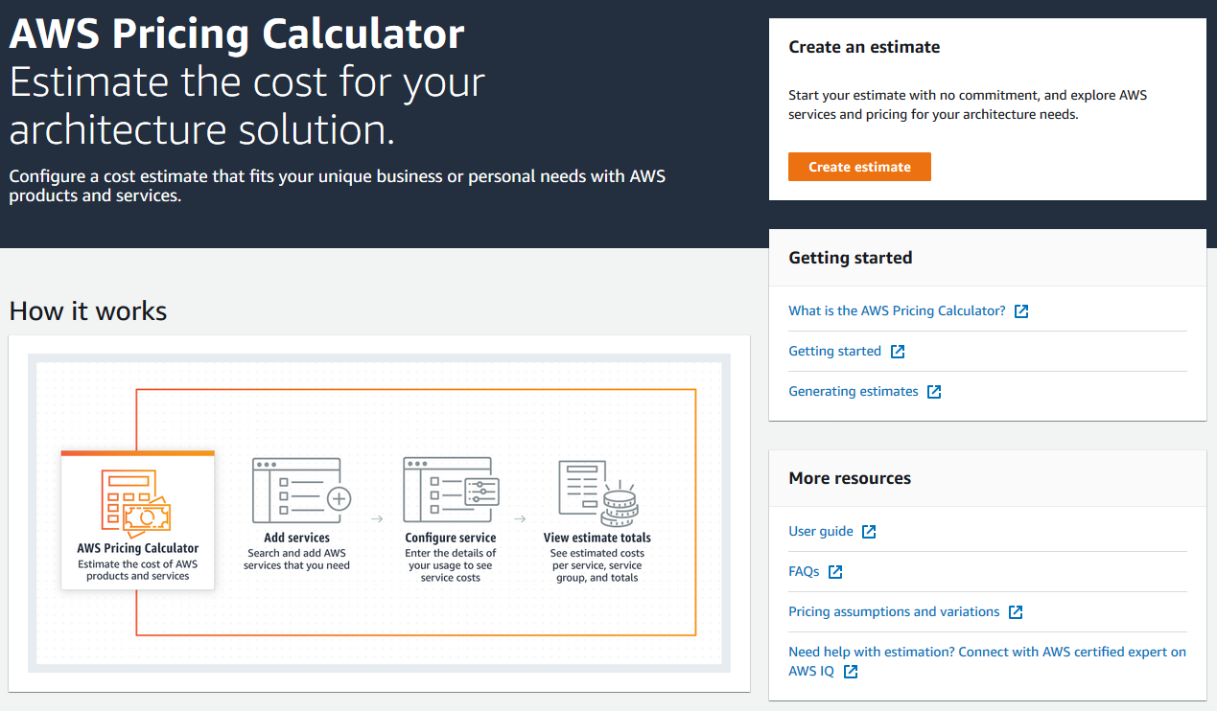
AWS Pricing Calculator
Use the AWS Pricing Calculator to:
Estimate monthly costs
Identify opportunities to reduce monthly costs
Model your solutions before building them
Explore price points and calculations behind your estimate
Find the available instance types and contract terms that meet your needs
Activity: AWS Pricing Calculator activity
Access the AWS Pricing Calculator

Slide 21
Section 3: AWS Organizations
Module 2: Cloud Economics and Billing

Slide 22
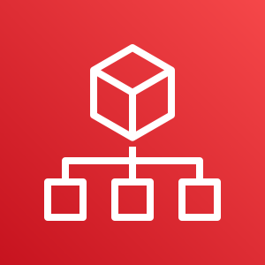
Introduction to AWS Organizations
AWS Organizations is a free account management service that enables you to consolidate multiple AWS accounts into an organization that you create and centrally manage.
AWS Organizations include consolidated billing and account management capabilities that help you to better meet the budgetary, security, and compliance needs of your business.
AWS Organizations

Slide 23
Introduction to AWS Organizations
The main benefits of AWS Organizations are:
Centrally managed access policies across multiple AWS accounts.
Controlled access to AWS services.
Automated AWS account creation and management.
Consolidated billing across multiple AWS accounts.
AWS Organizations

Slide 24
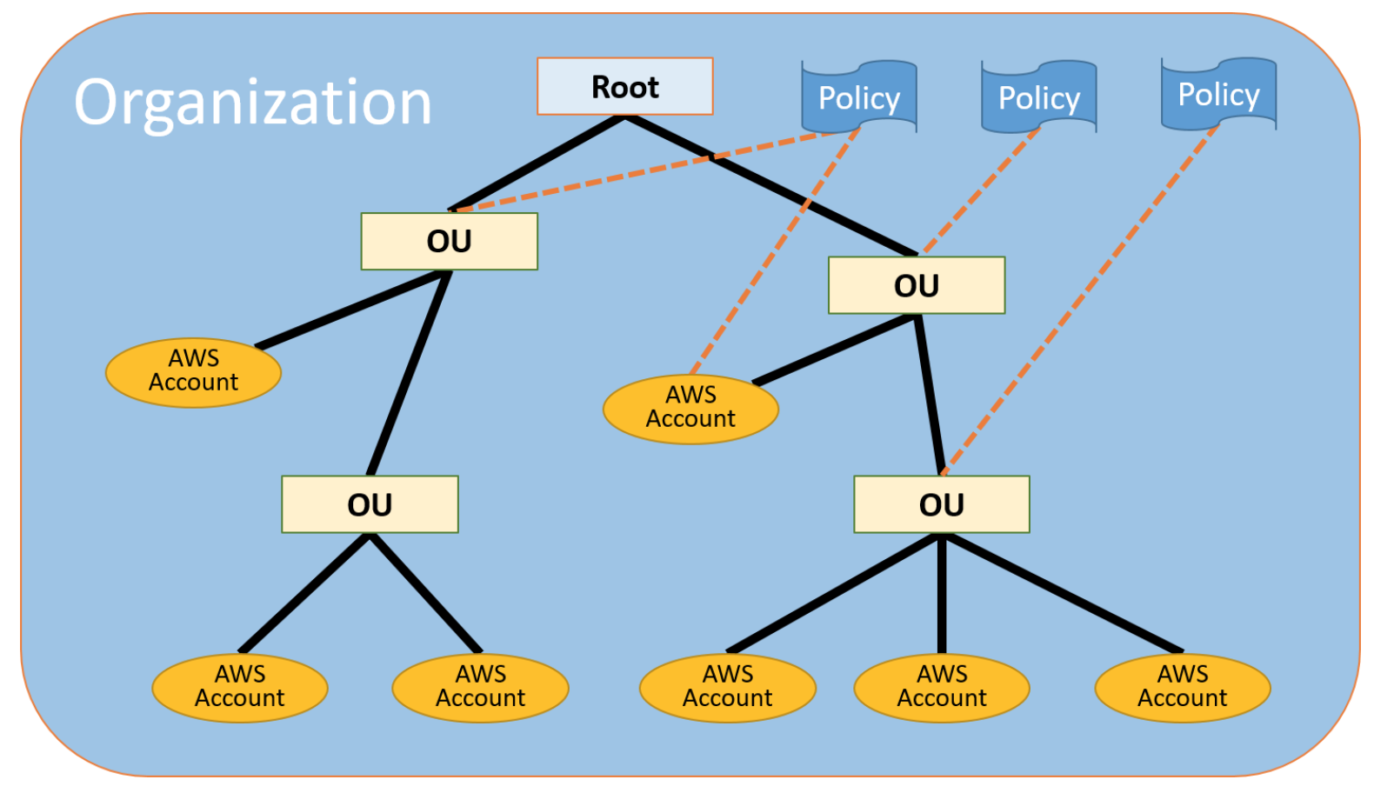
AWS Organizations terminology
*Organizational Units (OUs)
Notes:
Here is some terminology to understand the structure of AWS Organizations.
The diagram shows a basic organization, or root, that consists of seven accounts that are organized into four organizational units (or OUs). An OU is a container for accounts within a root. An OU can also contain other OUs. This structure enables you to create a hierarchy that looks like an upside-down tree with the root at the top. The branches consist of child OUs and they move downward until they end in accounts, which are like the leaves of the tree.
When you attach a policy to one of the nodes in the hierarchy, it flows down and it affects all the branches and leaves. This example organization has several policies that are attached to some of the OUs or are attached directly to accounts.
An OU can have only one parent and, currently, each account can be a member of exactly one OU. An account is a standard AWS account that contains your AWS resources. You can attach a policy to an account to apply controls to only that one account.

Slide 25

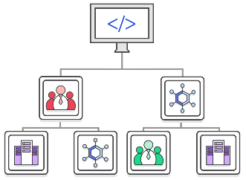

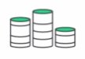
Key features and benefits
Policy-based account management
Group based account management
Application programming interfaces (APIs) that automate account management
AWS Organizations
Consolidated billing

Slide 26


Security with AWS Organizations
Service control policies (SCPs) enable you to allow or deny access to AWS services for individuals or group accounts in an organizational unit (OU).
Control access with AWS Identity and Access Management (IAM).
IAM policies enable you to allow or deny access to AWS services for users, groups, and roles.
Notes:
AWS Organizations does not replace associating AWS Identity and Access Management (IAM) policies with users, groups, and roles within an AWS account.
With IAM policies, you can allow or deny access to AWS services (such as Amazon S3), individual AWS resources (such as a specific S3 bucket), or individual API actions (such as s3:CreateBucket). An IAM policy can be applied only to IAM users, groups, or roles, and it can never restrict the AWS account root user.
In contrast, with Organizations, you use service control policies (SCPs) to allow or deny access to particular AWS services for individual AWS accounts or for groups of accounts in an OU. The specified actions from an attached SCP affect all IAM users, groups, and roles for an account, including the AWS account root user.

Slide 27



Organizations setup
Step 1
Step 2
Step 3
Step 4
Create Organization
Create organizational
units
Create
service
control
policies
Test
restrictions
Notes:
To learn more about the IAM policy simulator, see the IAM policy simulator at https://docs.aws.amazon.com/IAM/latest/UserGuide/access_policies_testing-policies.html.

Slide 28
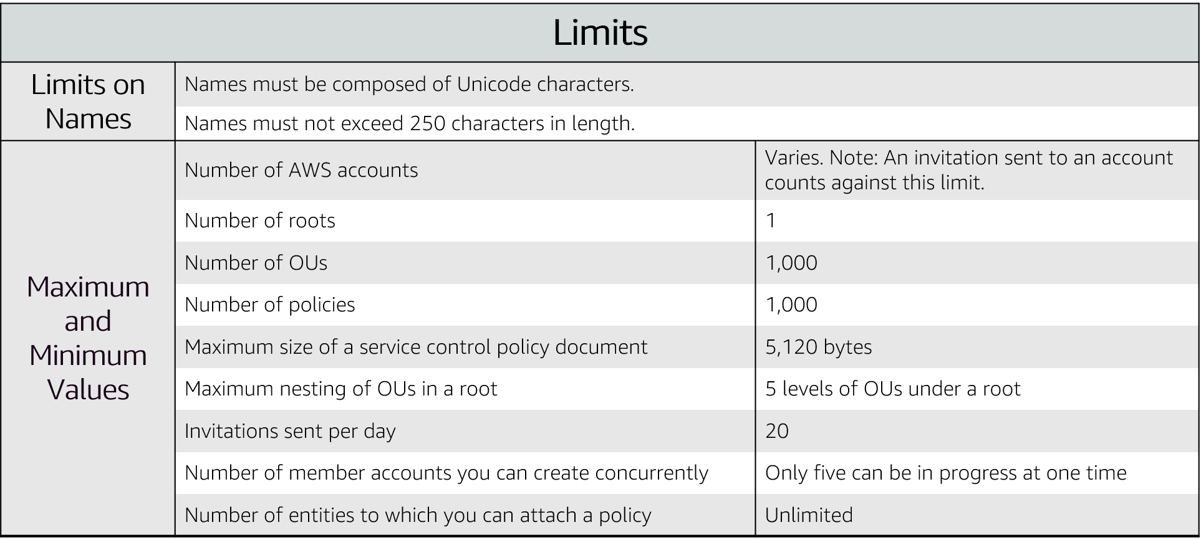
Limits of AWS Organizations

Slide 29



Accessing AWS Organizations
AWS Management Console
AWS Command Line Interface (AWS CLI) tools
Software development kits (SDKs)
AWS Organizations
HTTPS Query application programming interfaces (API)
Notes:
The AWS Organizations HTTPS Query API gives you programmatic access to AWS Organizations and AWS. You can use the API to issue HTTPS requests directly to the service. When you use the HTTPS API, you must include code to digitally sign requests by using your credentials.

Slide 30
Section 4: AWS Billing and Cost Management
Module 2: Cloud Economics and Billing

Slide 31
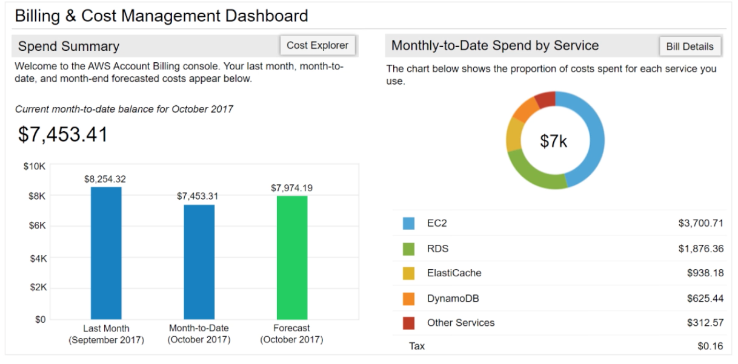
AWS Billing Dashboard
Notes:
The AWS Billing Dashboard lets you view the status of your month-to-date AWS expenditure, identify the services that account for the majority of your overall expenditure, and understand at a high level how costs are trending.
One of the graphs that is located on the dashboard is the Spend Summary. The Spend Summary shows you how much you spent last month, the estimated costs of your AWS usage for the month to date, and a forecast for how much you are likely to spend this month.
Another graph is Month-to-Date Spend by Service, which shows the top services that you use most and the proportion of costs that are attributed to that service.

Slide 32
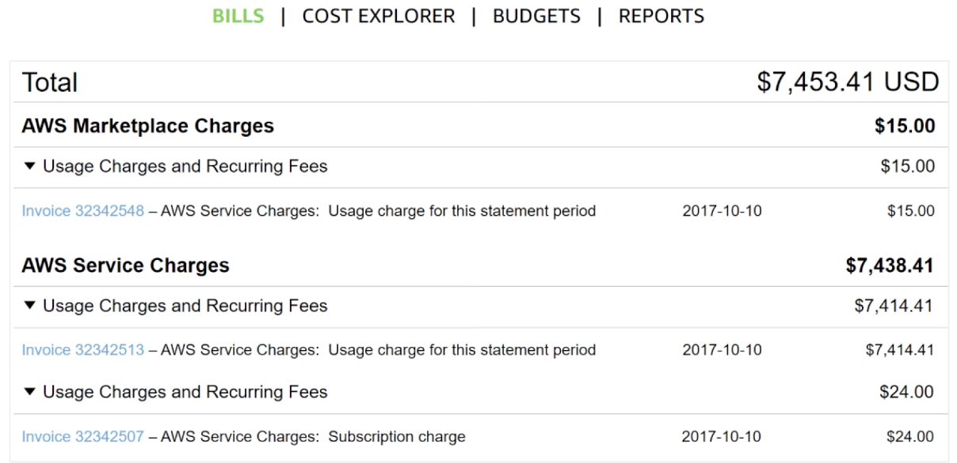
Monthly bills
Notes:
The AWS Bills page lists the costs that you incurred over the past month for each AWS service, with a further breakdown by AWS Region and linked account.
This tool gives you access to the most up-to-date information on your costs and usage, including your monthly bill and the detailed breakdown of the AWS services that you use.

Slide 33
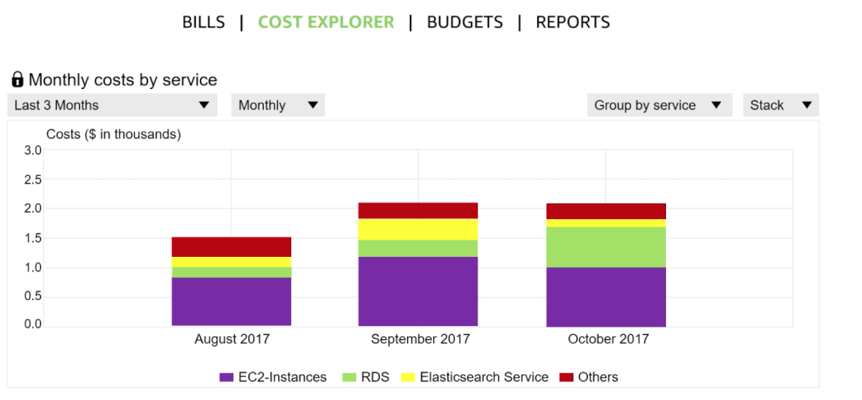
Cost Explorer
Notes:
The AWS Billing and Cost Management console includes the Cost Explorer page for viewing your AWS cost data as a graph.
With Cost Explorer, you can visualize, understand, and manage your AWS costs and usage over time.

Slide 34
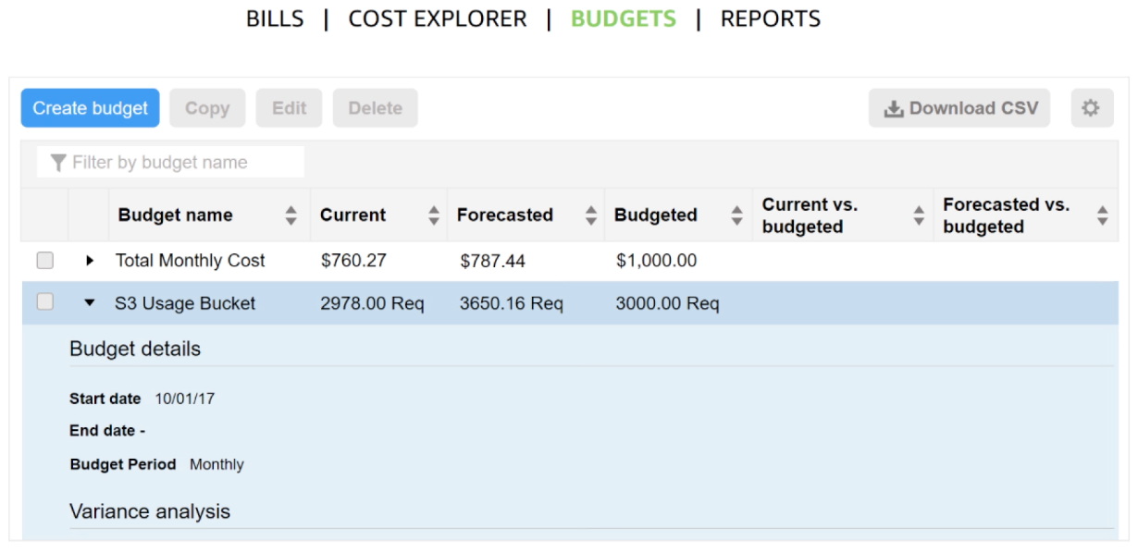
Forecast and track costs – Amazon SNS
Notes:
AWS Budgets uses the cost visualization that is provided by Cost Explorer to show you the status of your budgets and to provide forecasts of your estimated costs.
You can also use AWS Budgets to create notifications for when you go over your budget for the month, or when your estimated costs exceed your budget. Budgets can be tracked at the monthly, quarterly, or yearly level, and you can customize the start and end dates. Budget alerts can be sent via email or via Amazon Simple Notification Service (Amazon SNS).

Slide 35
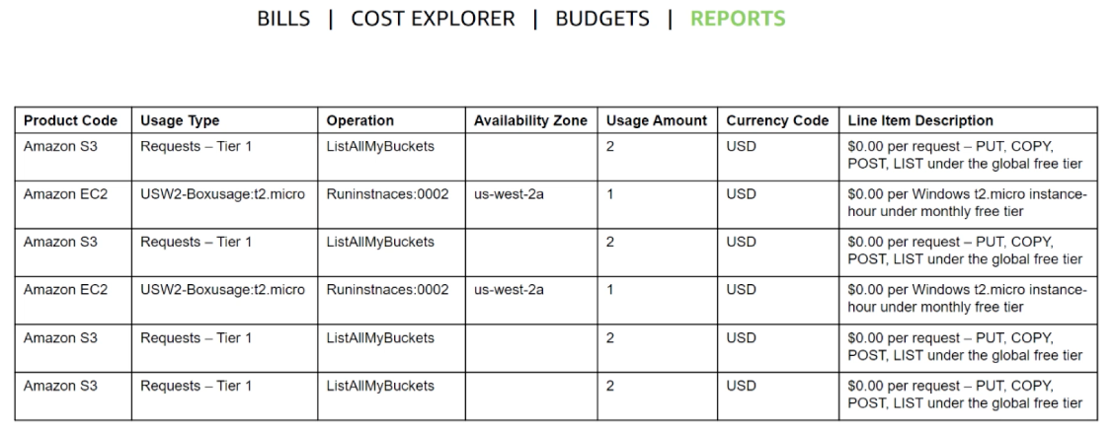
Cost and usage reporting - lists the usage for each service category
Notes:
The AWS Cost and Usage Report is a single location for accessing comprehensive information about your AWS costs and usage. This tool lists the usage for each service category that is used by an account (and its users) in hourly or daily line items, and any tax that you activated for tax allocation purposes.
You can choose to have AWS to publish billing reports to an S3 bucket. These reports can be updated once a day.

Slide 36
Section 5: Technical support
Module 2: Cloud Economics and Billing

Slide 37

AWS support (1 of 2)
Provide unique combination of tools and expertise:
AWS Support
AWS Support Plans
Support is provided for:
Experimenting with AWS
Production use of AWS
Business-critical use of AWS
Notes:
Whether you are new or continuing to adopt AWS services and applications as your business solutions, AWS want help you do amazing things with AWS. AWS Support can provide you with a unique combination of tools and expertise based on your current or future planned use cases.
AWS Support was developed to provide complete support and the right resources to aid your success. We want to support all our customers, including customers that might be experimenting with AWS, those that are looking for production uses of AWS, and also customers that use AWS as a business-critical resource. AWS Support can vary the type of support that is provided, depending on the customer’s needs and goals.

Slide 38

AWS support (2 of 2)
Proactive guidance :
Technical Account Manager (TAM)
Best practices :
AWS Trusted Advisor
Account assistance :
AWS Support Concierge
Notes:
With AWS, customers can plan, deploy, and optimize with confidence.
If you would like proactive guidance, AWS Support has Technical Account Managers (TAMs) who are designated as that user’s primary point of contact. The TAM can provide guidance, architectural review, and continuous ongoing communication to keep you informed and prepared as you plan, deploy, and optimize your solutions.
If you want to ensure that you follow best practices to increase performance and fault tolerance in the AWS environment, AWS Support has AWS Trusted Advisor. AWS Trusted Advisor is like a customized cloud expert. It is an online resource that checks for opportunities to reduce monthly expenditures and increase productivity.
For account assistance, the Support Concierge is a billing and account expert who will provide quick and efficient analysis on billing and account issues. The concierge addresses all non-technical billing and account-level inquiries.

Slide 39

Support plans
AWS Support offers four support plans:
Basic Support – Resource Center access, Service Health Dashboard, product FAQs, discussion forums, and support for health checks
Developer Support: Support for early development on AWS
Business Support: Customers that run production workloads
Enterprise Support: Customers that run business and mission-critical workloads
Notes:
AWS wants you to be able to plan, deploy, and optimize with confidence. We have developed specific plans to support you, including Basic, Developer, Business, and Enterprise support plans.
The Basic Support Plan offers:
24/7 access to customer service, documentation, whitepapers and support forums.
Access to six core Trusted Advisor checks.
Access to Personal Health Dashboard.
The Developer Support Plan offers resources for customers that are testing or doing early development on AWS, and any customers who:
Want access to guidance and technical support.
Are exploring how to quickly put AWS to work.
Use AWS for non-production workloads or applications.
The Business Support Plan offers resources for customers that are running production workloads on AWS, and any customers who:
Run one or more applications in production environments.
Have multiple services activated, or use key services extensively.
Depend on their business solutions to be available, scalable, and secure.
The Enterprise Support Plan offers resources for customers that are running business and mission-critical workloads on AWS, and any customers who want to:
Focus on proactive management to increase efficiency and availability.
Build and operate workloads that follow AWS best practices.
Use AWS expertise to support launches and migrations.
Use a Technical Account Manager (TAM), who provides technical expertise for the full range of AWS services and obtains a detailed understanding of your use case and technology architecture. The Technical Account Manager is the primary point of contact for ongoing support needs.

Slide 40
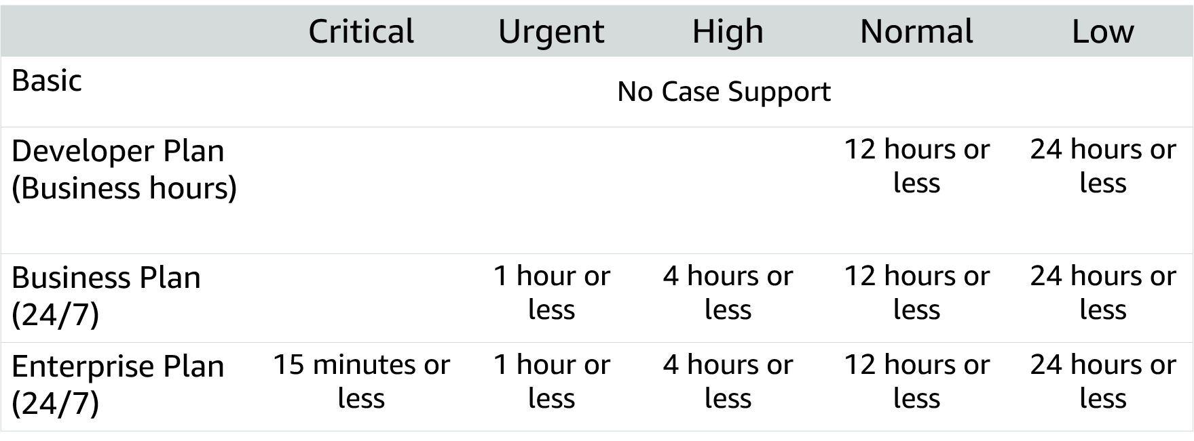
Case severity and response times
Notes:
It addition to understanding the costs that are associated with different support plans, it is critical that you understand the service levels that are associated with each plan. In addition to the support plan you select, the case severity will drive the type of response that you receive. There are five different severity levels:
Critical – Your business is at risk. Critical functions of your application are unavailable.
Urgent – Your business is significantly impacted. Important functions of your application are unavailable.
High – Important functions of your application are impaired or degraded.
Normal – Non-critical functions of your application are behaving abnormally, or you have a time-sensitive development question.
Low – You have a general development question, or you want to request a feature.
Note that there is no case support with the Basic Support Plan. These response times should be considered when you determine which support plan is best for your organization.
To learn more about AWS Support plans, see Compare AWS Support Plans at https://aws.amazon.com/premiumsupport/plans/.
For accessibility: Case severity response times for the four different support levels (basic, developer plan, business plan, and enterprise plan, each with more support respectively. End of accessibility description.

Slide 41
Module wrap-up
Module 2: Cloud Economics and Billing
Notes:
It’s now time to review the module and wrap up with a knowledge check and discussion of a practice certification exam question.

Slide 42
Module summary
Explored the fundamental of AWS pricing
Reviewed TCO concepts
Reviewed an AWS Pricing Calculator estimate
Reviewed the Billing dashboard
Reviewed Technical Support options and costs
Notes:
In summary you:
Explored the fundamentals of AWS pricing
Reviewed Total Cost of Ownership concepts
Reviewed an AWS Pricing Calculator estimate.
Total Cost of Ownership is a concept to help you understand and compare the costs that are associated with different deployments. AWS provides the AWS Pricing Calculator to assist you with the calculations that are needed to estimate cost savings.
Use the AWS Pricing Calculator to:
Estimate monthly costs
Identify opportunities to reduce monthly costs
Model your solutions before building them
Explore price points and calculations behind your estimate
Find the available instance types and contracts that meet your needs
AWS Billing and Cost Management provides you with tools to help you access, understand, allocate, control, and optimize your AWS costs and usage. These tools include AWS Bills, AWS Cost Explorer, AWS Budgets, and AWS Cost and Usage Reports.
These tools give you access to the most comprehensive information about your AWS costs and usage including which AWS services are the main cost drivers. Knowing and understanding your usage and costs will enable you to plan ahead and improve your AWS implementation.

Slide 43
Additional resources
AWS Economics Center: http://aws.amazon.com/economics/
AWS Pricing Calculator: https://calculator.aws/#/
Case studies and research: http://aws.amazon.com/economics/
Additional pricing exercises: https://dx1572sre29wk.cloudfront.net/cost/
Notes:
If you want to learn more about the topics covered in this module, you might find the following additional resources helpful:
AWS Economics Center: http://aws.amazon.com/economics/
AWS Pricing Calculator: https://calculator.aws/#/
Case studies and research: http://aws.amazon.com/economics/
Additional pricing exercises: https://dx1572sre29wk.cloudfront.net/cost/

Slide 44
Thank you
All trademarks are the property of their owners.
Notes:
Thank you for completing this module.

